Slide 1

Sean Chase
Jerome Schneider

Slide 2


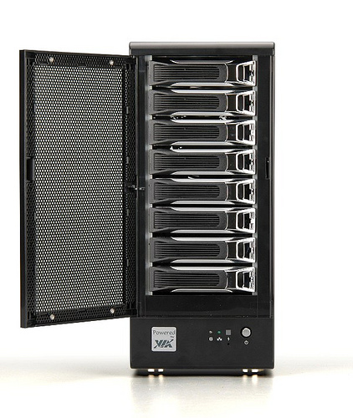
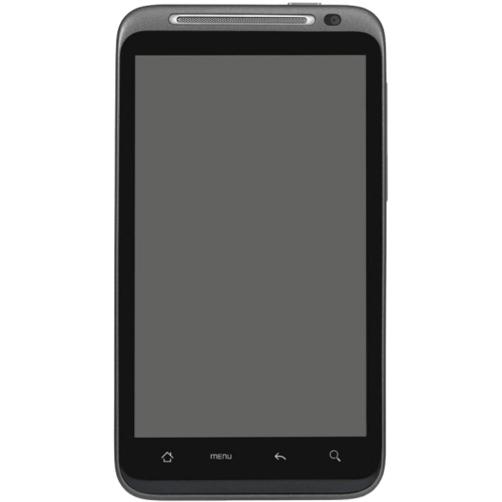
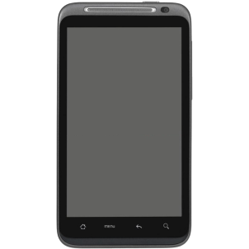


Slide 3
How BlueMesh Works

Slide 4
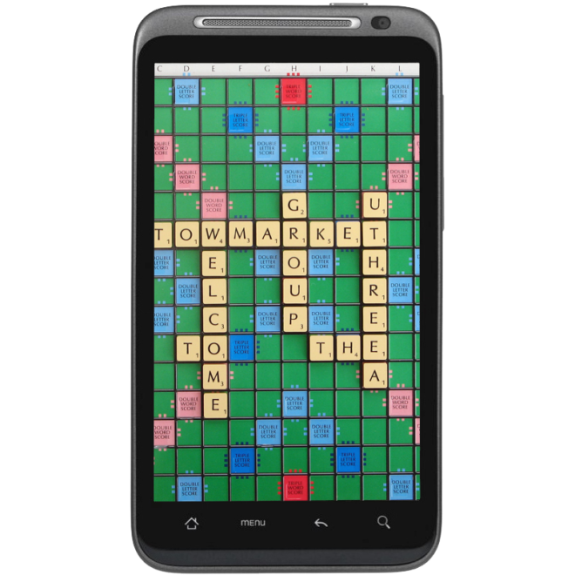

Slide 5
User
Application
BlueMesh
Service
Object
Router
Object
Client
Thread
Server
Thread
Read/Write
Thread
Read/Write
Thread
Read/Write
Thread
. . .

Slide 6
Goals:
Allow for other devices to use BlueMesh
Fix Termination Bug
Allow for messages of any size
Allow message routing

Slide 7

BlueCove Library

Slide 8
Thanks!
Sean O’Sullivan
Cap’n Moorthy
RCOS members

Slide 9
Questions?

